Slide 1
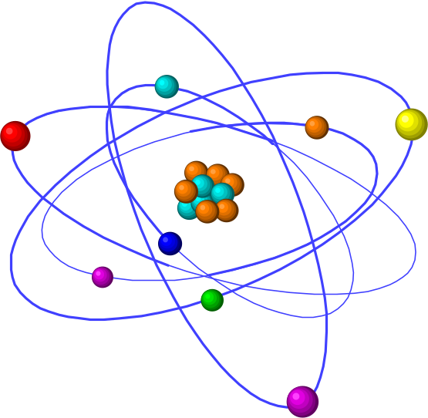
Acids and Bases

Slide 2
Revision
Acid and base → salt, water
Acid and carbonate → salt, water and CO₂
Acid and hydrogen carbonate → as above
Acid and metal → salt and H₂
Acid and metal oxide → salt and water
Acid and metal sulfide → salt, water, SO₂
Base and non metal oxide → salt and water
Base and ammonium salt → salt and NH₃

Slide 3
Properties of Acids
Turn blue litmus red
Conduct electric currents
Taste sour
pH <7
Strong acid ionises completely and has high concentration of H+ions.
Weak acids partially ionises and form ↔

Slide 4
Properties of Bases
Turn red litmus blue
Conduct electric currents
Taste bitter, chalky
pH >7
Strong bases dissociate completely and has high concentration of OH- ions.
Weak bases partially dissociate and form ↔

Slide 5
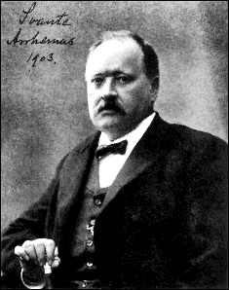
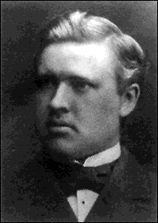
Svante Arrhenius (1859-1927)

Slide 6
Arrhenius Definition
Acids produce hydrogen ions (H⁺) in aqueous solution.
Bases produce hydroxide ions (OH⁻) when dissolved in water.
Limited to aqueous solutions.
Only one kind of base (hydroxides)
NH₃ (ammonia) could not be an Arrhenius base.

Slide 7
Arrhenius Acids and Bases
Acids produce H⁺ in aqueous solutions
water
HCl H⁺(aq) + Cl⁻ (aq)
Bases produce OH⁻ in aqueous solutions
water
NaOH Na⁺(aq) + OH⁻ (aq)

Slide 8
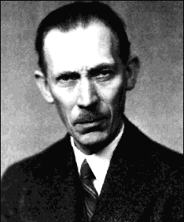
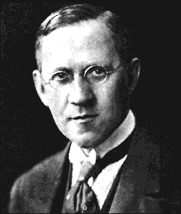
Johannes Bronsted / Thomas Lowry
(1879-1947) (1874-1936)

Slide 9
Brønsted-Lowry Definitions
Acid is hydrogen-ion donor (H⁺ or proton)
Base is hydrogen-ion acceptor.
Acids and bases always come in pairs.
For example
HCl is an acid.
  When it dissolves in water, it gives it’s proton to water.
HCl(g) + H₂O(l) H₃O⁺ + Cl⁻
Water is a base; makes hydronium ion.

Slide 10
Bronsted-Lowry Acids and Bases
Acids are hydrogen ion (H⁺⁾ donors
Bases are hydrogen ion (H⁺) acceptors
HCl + H₂O H₃O⁺ + Cl⁻
donor acceptor + -
+ +

Slide 11
Acids and bases come in pairs...
A conjugate base is the remainder of the original acid, after it donates it’s hydrogen ion.
A conjugate acid is the particle formed when the original base gains a hydrogen ion.

Slide 12
Acids and bases come in pairs...
General equation is: A=anion
HA(aq) + H₂O(l) ↔ H₃O⁺(aq) + A⁻(aq)
Acid + Base → Conjugate acid + Conjugate base
NH₃ + H₂O → NH₄⁺ + OH⁻
base acid ← c.a. c.b.
HCl + H₂O → H₃O⁺ + Cl⁻
acid base ← c.a. c.b.
Amphoteric - acts as acid or base, water here.

Slide 13
Amphoteric
Element, molecule or ion that can react with both acid and base.
Some metals eg Al, Zn
Some metal oxides
And some ions
Eg bicarbonate ion
HCO₃⁻ + H⁺ → H₂CO₃
HCO₃⁻ + OH⁻ → CO₃²⁻ + H₂O

Slide 14
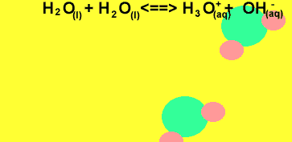
Ionisation of water
Water is a weak electrolyte
H₂O_{(l)} + H₂O_{(l)} ↔ H₃O⁺_{(aq)} + OH⁻_{(aq)}
K_{w} = [H⁺] [OH⁻] = 1.0 x 10⁻¹⁴ (at 25ºC)
Where K_{w} is the equilibrium constant
For pure water
[H⁺] = [OH⁻] = 1.0 x 10⁻⁷ mol.L⁻¹

Slide 15
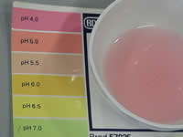
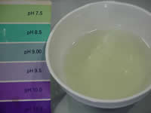
The pH scale
pH = -log10[H⁺]
Where [H⁺] is the concentration of H⁺ ions.
> 7 basic
= 7 neutral
< 7 acidic

Slide 16
Strengths of Acids and Bases
Strong acids and bases are strong electrolytes
  ionise completely.
  Weak acids don’t completely ionise.
Strength different from concentration
Strong-forms many ions when dissolved
CaO is a strong base- it falls completely apart when dissolved.
But, if not much dissolves- not concentrated

Slide 17
Strength vs. Concentration
The words concentrated and dilute tell how much of an acid or base is dissolved in solution - refers to the number of moles of acid or base in a given volume
The words strong and weak refer to the extent of ionisation of an acid or base
Is concentrated weak acid possible?

Slide 18
Strong and Weak
Acids and Bases
Strong acids
HCl, HNO₃ , H₂SO₄
Most other acids are weak. eg H₃PO₄, CH₃COOH
Strong bases
NaOH, KOH, and CaO
Most other bases are weak. eg NH_{3,} Na₂CO₃

Slide 19
NH₃, A Bronsted-Lowry Base
When NH₃ reacts with water, most of the reactants remain dissolved as molecules, but a few NH₃ reacts with water to form NH₄⁺ and hydroxide ion.
NH₃ + H₂O NH₄⁺(aq) + OH⁻ (aq)
acceptor donor
+ +

Slide 20
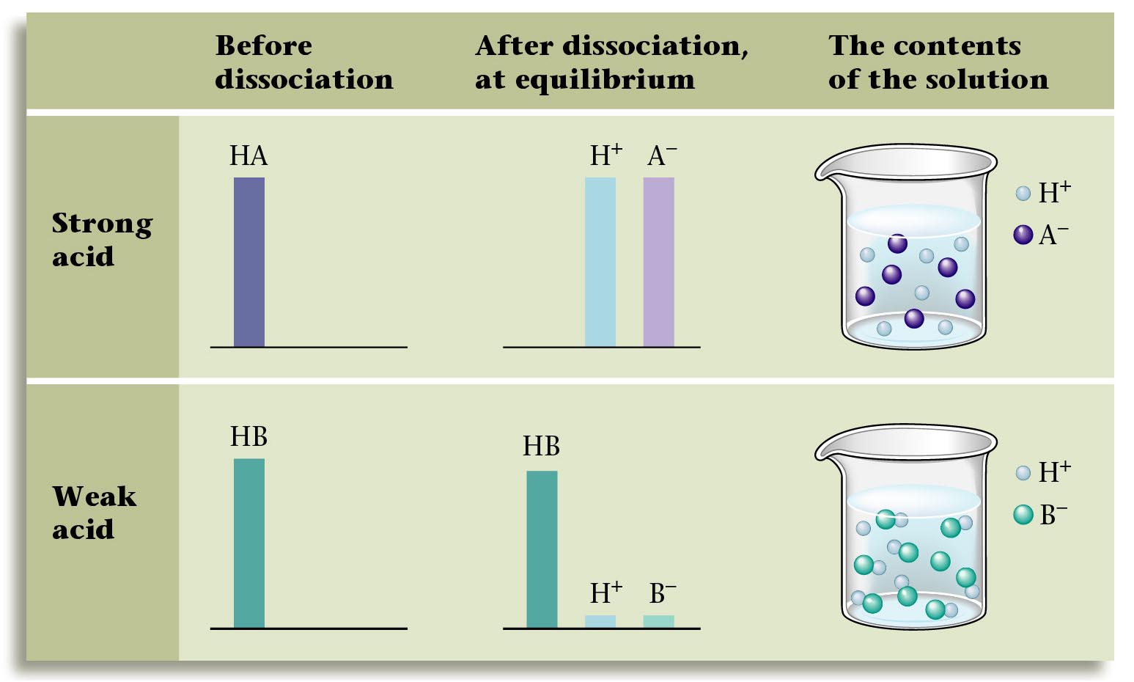

Slide 21
Acid Ionisation Constants
Ionization is reversible.
HA H⁺ + A^{- where A=anion}
This makes an equilibrium
Acid dissociation constant = K_{a}
K_{a} = [H⁺ ][A⁻ ] (water is constant) [HA]
Stronger acid = more products (ions), thus a larger K_{a}

Slide 22
Polyprotic Acids
Some compounds have more than 1 ionisable hydrogen.
HNO₃ nitric acid – monoprotic
H₂SO₄ sulfuric acid - diprotic - 2 H⁺
H₃PO₄ phosphoric acid - triprotic - 3 H⁺
Having more than one ionisable hydrogen does not mean stronger!

Slide 23
Consecutive dissociations are weaker
For example
H₂SO_{4(l)} + H₂O_{(l)}  H₃O⁺_{(aq)} + HSO₄⁻_{(aq)}
is strong however the second dissociation is weak
HSO₄⁻_{(aq)} + H₂O_{(l)}  H₃O⁺_{(aq)} + SO₄²⁻_{(aq)}
Note for bases such as Mg(OH)₂, Ca(OH)₂ etc
Provide 2 moles of OH⁻ per 1 mole of base.

Slide 24

Acidity of Aqueous Solutions of Salt
If an anion or cation hydrolyses water the solution will be acidic or basic.
C⁺ + H₂O COH + H⁺ acidic
A⁻ + H²O HA + OH⁻ basic
If the anion or cation is the conjugate pair of a weak acid or base then it will hydrolise water.
If the anion or cation is the conjugate pair of a strong acid or base it will not hydrolise water.
Note, the anion of a polyprotic acid (1st proton ionised will hydrolise water.

